Slide 1
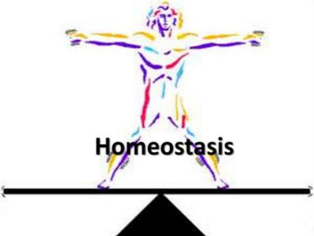
All body systems work together to keep the body in balance

Slide 2
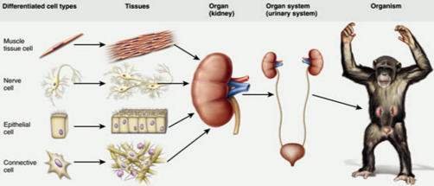
Levels of Organization
Organ
Organ System
Two or more types of tissues working together to perform a function
Different organs that cooperate to carry out a life process
Examples: Coordinate body activities, exchange gases, transport materials

Slide 3
Connecting Body Systems
Food in
Oxygen in
Digestive System
Respiratory System
Carbon dioxide out
nutrients
Oxygen
CO2
Cardiovascular System
Nutrients and oxygen
CO2 and wastes
wastes
Urinary System
Cells

Slide 4
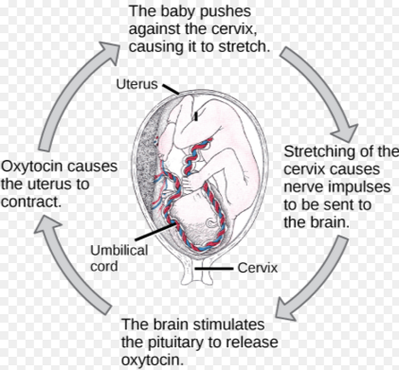
Body Systems Regulated by….
Hormones released by brain
Nerves
Work as a feedback loop (can be + or -)

Slide 5
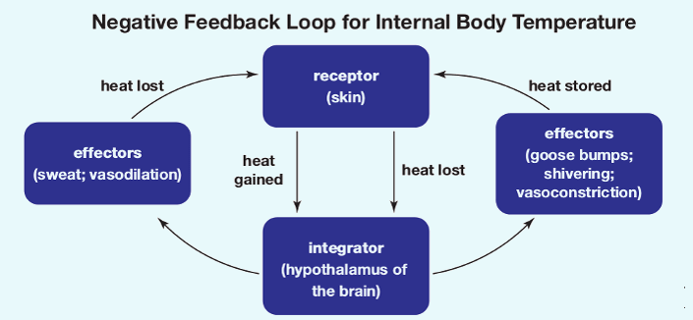
Negative Feedback Loop
Primary mechanism
2 components : Sensor and Control center
Input results in an opposite output

Slide 6
Feedback Loop - Thermoregulation
Too hot (stimulus)
Thermostat (sensor)
Furnace turns off (control center)
Response?
Too cold
Sensor
Control center: furnace (hypothalamus)
Furnace is on
Response?

Slide 7
Regulation of Body Temperature
Sensor: nerves connected to brain
Control Center: hypothalmus
Response: nervous system activates blood vessels and sweat glands

Slide 8
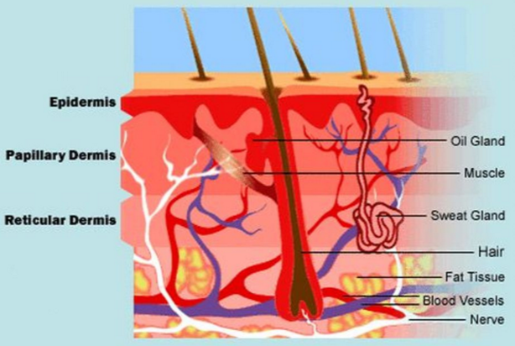
Integumentary System
Organs
Function
Skin
Hair
Nails
Sweat glands
First line of defense against pathogens
Thermoregulation
Control water loss
Produce vitamin D (necessary for calcium storage)

Slide 9
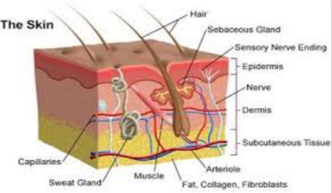
Skin
Largest organ
3 types of tissues
Epidermis
Dermis
Subcutaneous
Injuries
Cuts
Burns

Slide 10
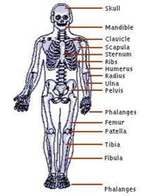
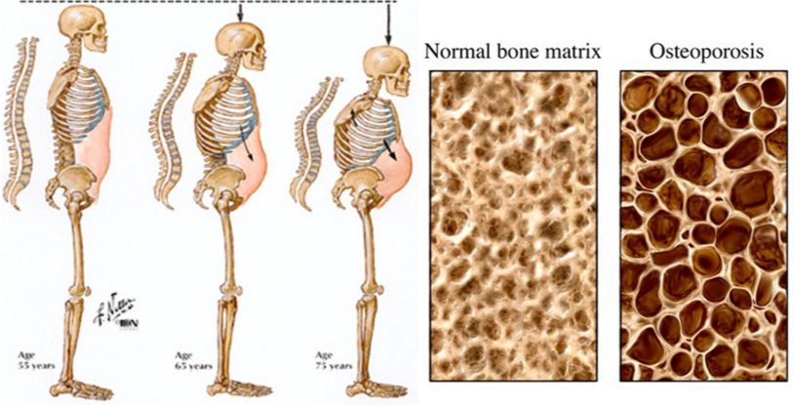
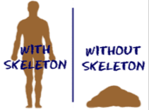
Skeletal System
Function
Injuries
Support
Protect vital organs
Muscle attachment
Stores calcium (muscle contraction and nerve conduction) and phosphate
Produces blood cells (transport oxygen, immune system)
Broken bones
Concussion
Torn ligaments
Osteoporosis
Leukemia

Slide 11
Feedback Loop
Heathy bones must store Calcium – requires a balance b/tw Calcitonin and PTH (parathyroid stimulating hormone)
If there is a high amount of Ca in diet:
Thyroid gland secrete calcitonin into blood, bones absorb Calcium, blood Ca drops
If there isn’t enough Ca²⁺ in diet:
Parathyroid glands release PTH, causing bones to release stored Ca²⁺
Vitamin D causes intestines to absorb more Ca²⁺ from food, blood Ca²⁺ rises
Over time, leads to loss of calcium from bones (osteoporosis)

Slide 12
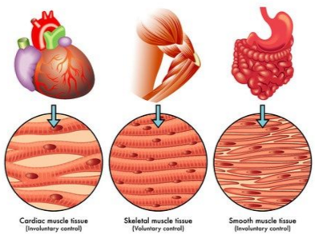
Muscular System
Functions
Three Types of Muscle
Maintain posture
Support
Allow movement
Maintain constant body temperature
Circulation of blood
Smooth
Striated (skeletal)
Cardiac

Slide 13
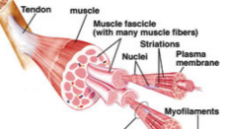
Muscle Action
Muscles can only contract /shorten/pull
Tendons connect muscle to bone
Origin is stationary bone
Insertion - attachment to movable bone
Work in antagonistic (opposing) pairs
Requires calcium to start contraction

Slide 14
Example: Knee Joint
Ligaments hold bone to bone and provide stability to the joint
Tendons hold muscle to bone that provide movement of the knee

Slide 15
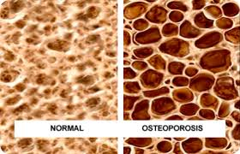
Osteoporosis means porous bones

Slide 16
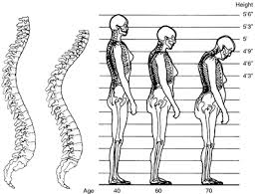
Deterioration of the Spine causes stooping in older people

Slide 17
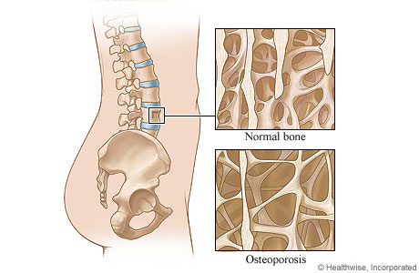

Slide 18
Connections?

